Slide 1
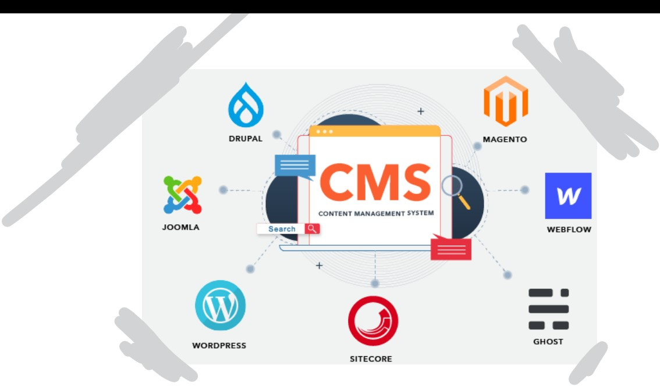
Content Management System
INSTRUCTOR: Sir Farooq Iqbal
Team members:
1- SYEDA ANSHRAH GILLANI
2-Umema Mujeeb
3-Maheen ALI
4-AREEJ ASIF

Slide 2
Vision
To develop a robust Content Management System that empowers users to efficiently create, manage, and publish digital content for websites. The system aims to streamline content workflows, enhance collaboration, and provide a user-friendly interface for content creators and administrators

Slide 3
SCOPE
The CMS will include features for content creation, editing, version control, user management, and publishing. It will support various content types such as articles, images, and videos. The system will prioritize scalability, security, and ease of use, catering to the needs of both small businesses and large enterprises

Slide 4
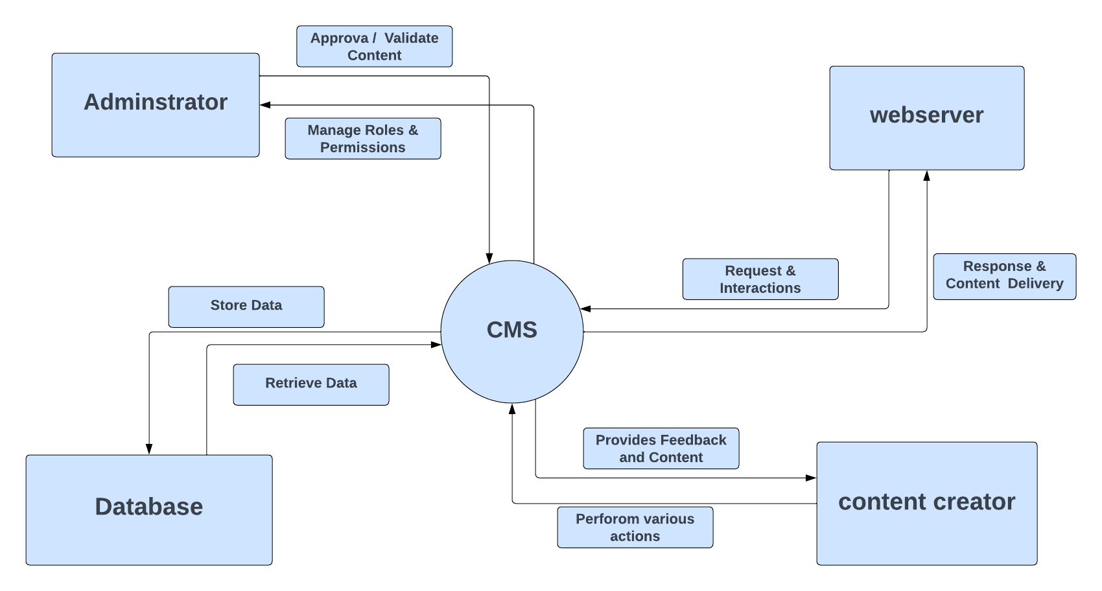
1- Context daigram

Slide 5
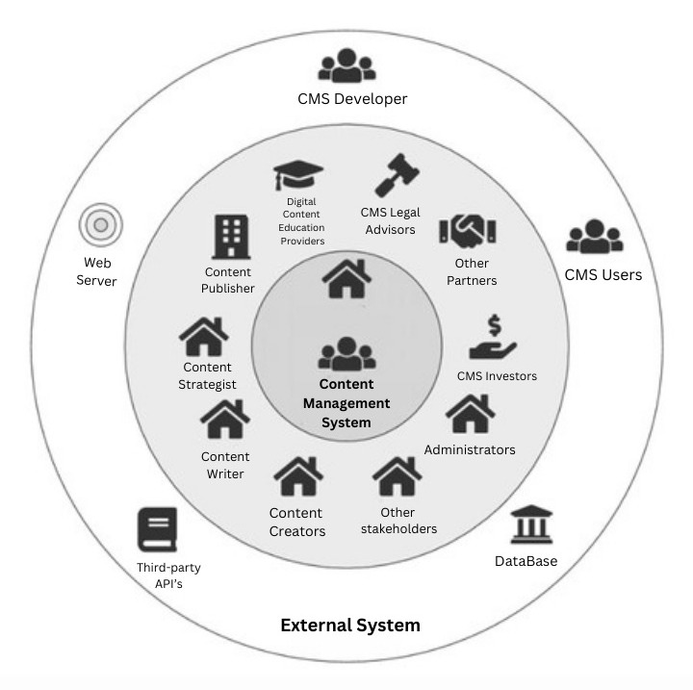
2- ECO System Map

Slide 6
Domain Analysis “Problem Definition”
The problem is to create a CMS that addresses the challenges of content creation, management, and publication, ensuring efficiency, collaboration, and security.

Slide 7
“Dictionary of Terms”
1. Content: Digital information such as text, images, and videos.
2. User: Individuals interacting with the CMS.
3. Administrator: User with elevated privileges for system configuration.
4. Version Control: System for tracking and managing content changes.
5. Workflow: Defined sequence of steps for content creation, review, and publication.

Slide 8
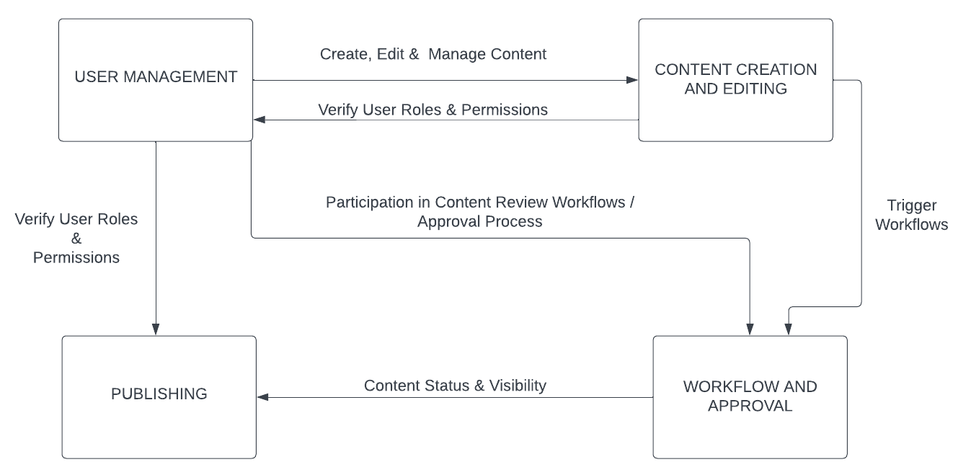
Subsystems Communication

Slide 9
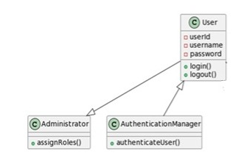
1.User Management Subsystem Class Diagram:

Slide 10
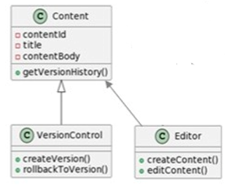
2. Content Creation and Editing Subsystem Class Diagram:

Slide 11
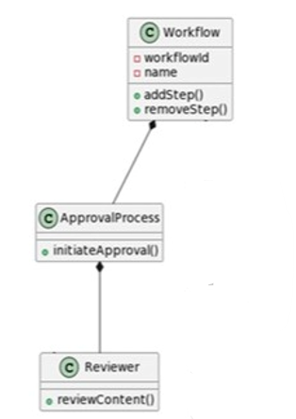
3. Workflow and Approval Subsystem Class Diagram:

Slide 12
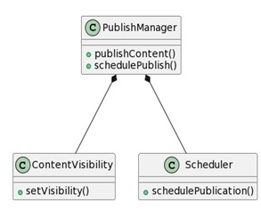
4. Publishing Subsystem Class Diagram:

Slide 13
THANK YOU

